Slide 1


Slide 2
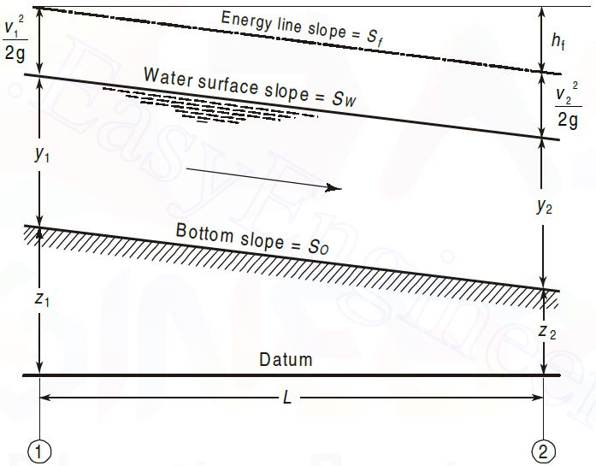
Uniform flow
Main features
The depth of flow, wetted area, velocity of flow and discharge are constant at every section along the channel reach.
The total energy line, water surface and the channel bottom are all parallel, that is, their slopes are all equal, or S_{f} = S_{w} = S₀ = S

Slide 3
Non-Uniform flow
Non-Uniform Flow is also called Varied Flow
Flow in which the Water Depth and/or Discharge change along the length of the channel
It can be further classified as
  Gradually Varied Flow (GVF) where the depth of the flow changes gradually along the length of the channel
  Rapidly Varied Flow (RVF) where the depth of flow changes suddenly over a small length of the channel

Slide 4
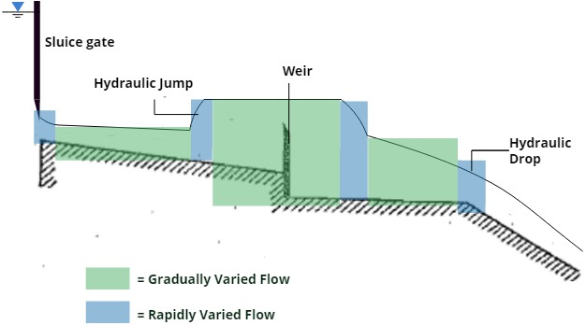
Non-uniform flow

Slide 5
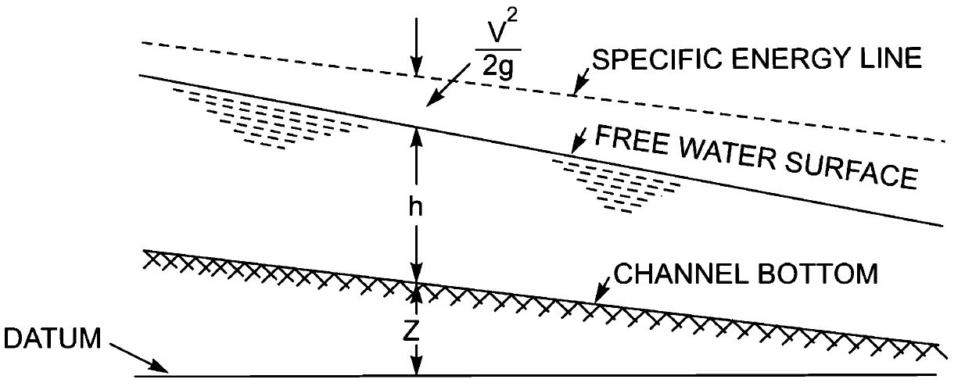
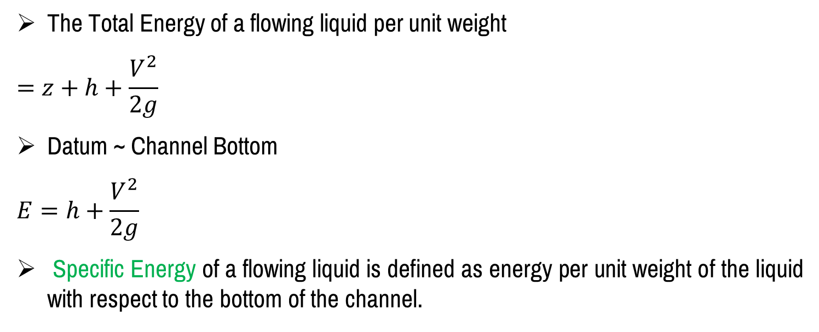
Specific energy
The Total Energy of a flowing liquid per unit weight
$$=z+h+\frac{V^{2}}{2g}$$
Datum ~ Channel Bottom
$$E=h+\frac{V^{2}}{2g}$$
Specific Energy of a flowing liquid is defined as energy per unit weight of the liquid with respect to the bottom of the channel.

Slide 6
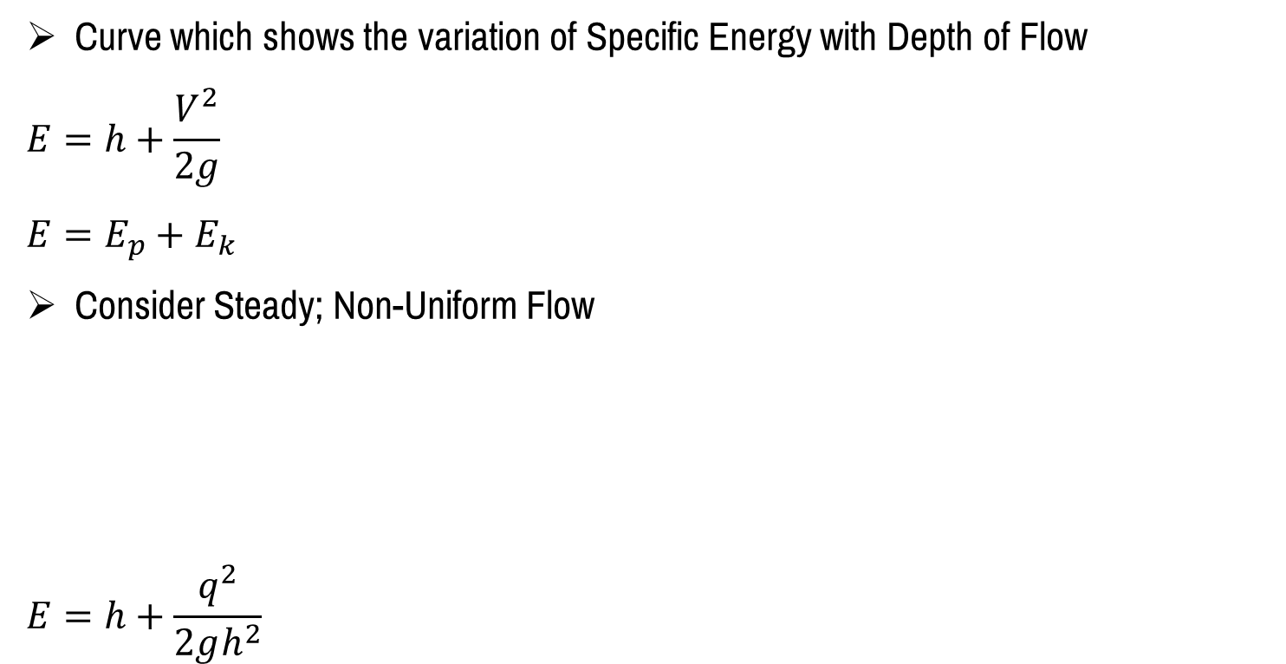
Specific energy curve
Curve which shows the variation of Specific Energy with Depth of Flow
$$E=h+\frac{V^{2}}{2g}$$
$$E=E_{p}+E_{k}$$
Consider Steady; Non-Uniform Flow
$$E=h+\frac{q^{2}}{2gh^{2}}$$

Slide 7
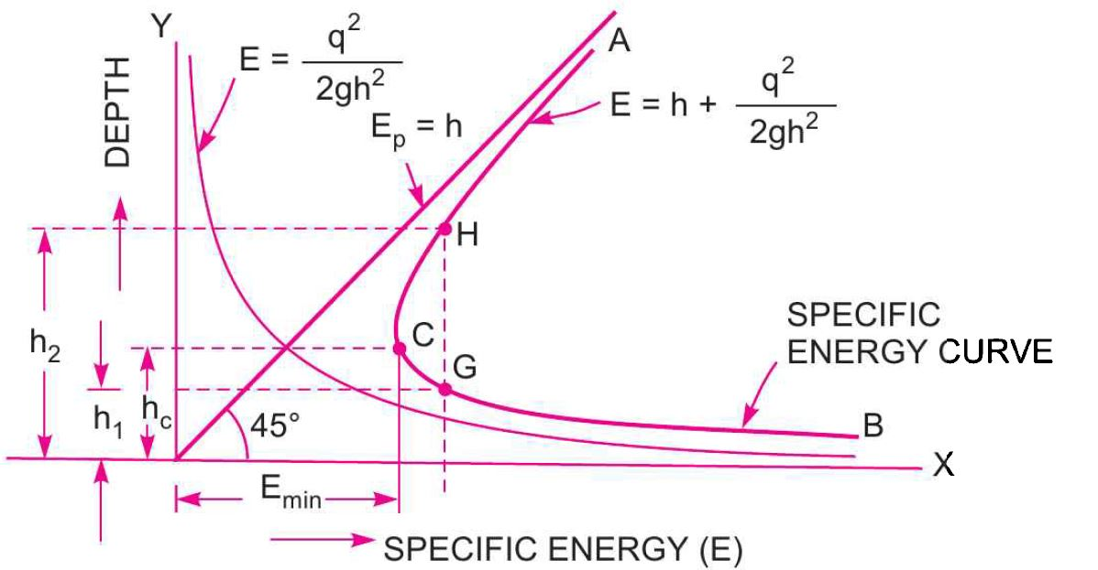
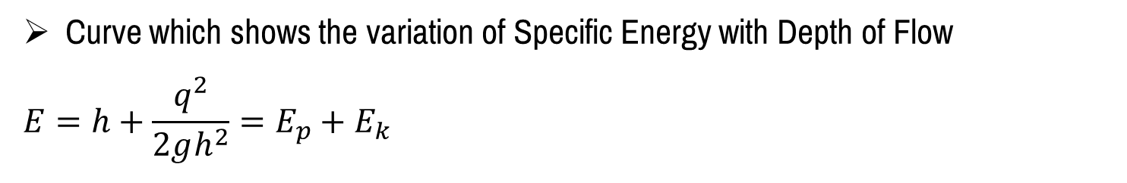
Specific energy curve
Curve which shows the variation of Specific Energy with Depth of Flow
$$E=h+\frac{q^{2}}{2gh^{2}}=E_{p}+E_{k}$$

Slide 8
Critical depth, h_{c}
It is the depth of flow of water at which the specific energy is minimum.

Slide 9
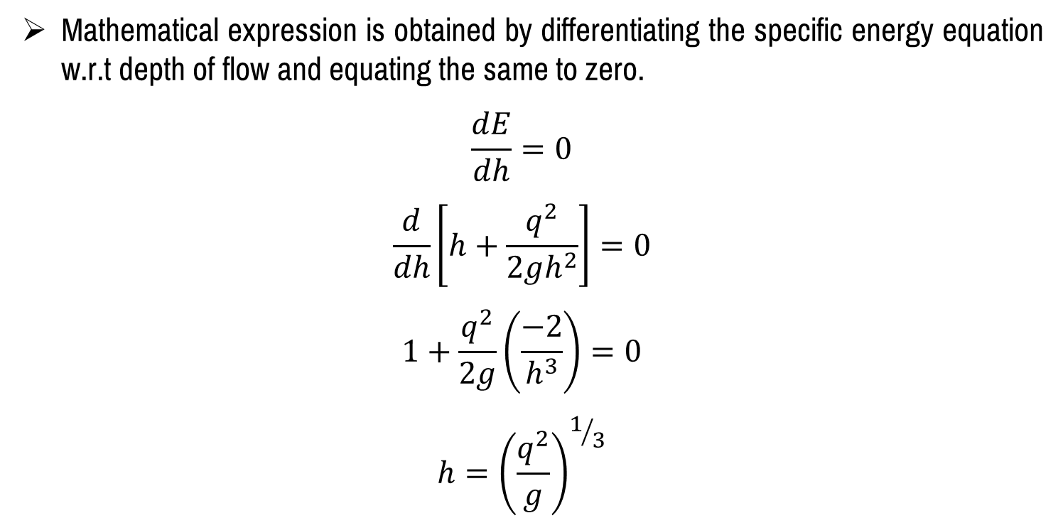
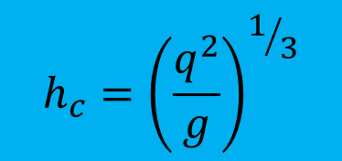
Critical depth, h_{c}
Mathematical expression is obtained by differentiating the specific energy equation w.r.t depth of flow and equating the same to zero.
$$\frac{dE}{dh}=0$$
$$\frac{d}{dh}\left[h+\frac{q^{2}}{2gh^{2}}\right]=0$$
$$1+\frac{q^{2}}{2g}\left(\frac{−2}{h^{3}}\right)=0$$
$$h={\left(\frac{q^{2}}{g}\right)}^{1/3}$$
$$h_{c}={\left(\frac{q^{2}}{g}\right)}^{1/3}$$

Slide 10
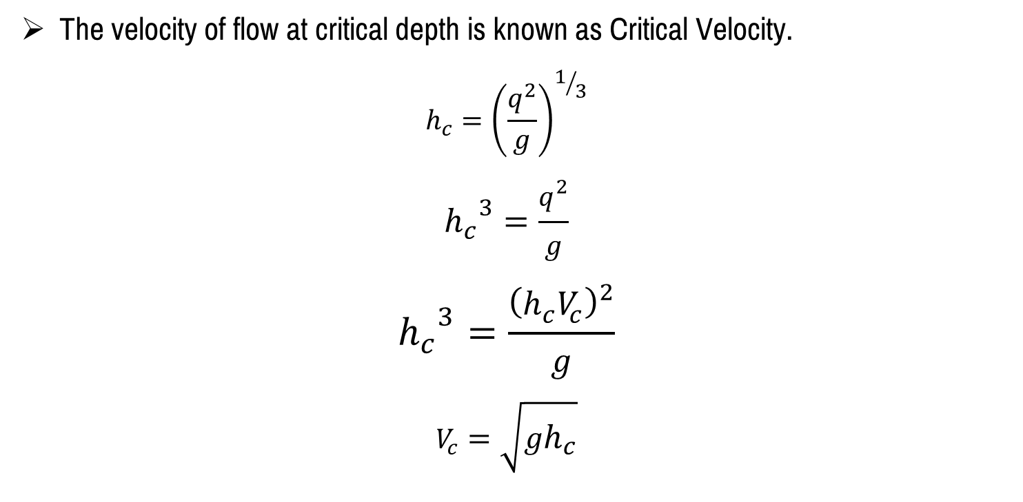
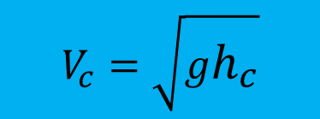
Critical velocity, V_{c}
The velocity of flow at critical depth is known as Critical Velocity.
$$h_{c}={\left(\frac{q^{2}}{g}\right)}^{1/3}$$
$${h_{c}}^{3}=\frac{q^{2}}{g}$$
$${h_{c}}^{3}=\frac{{\left(h_{c}V_{c}\right)}^{2}}{g}$$
$$V_{c}=\sqrt{gh_{c}}$$
$$V_{c}=\sqrt{gh_{c}}$$

Slide 11
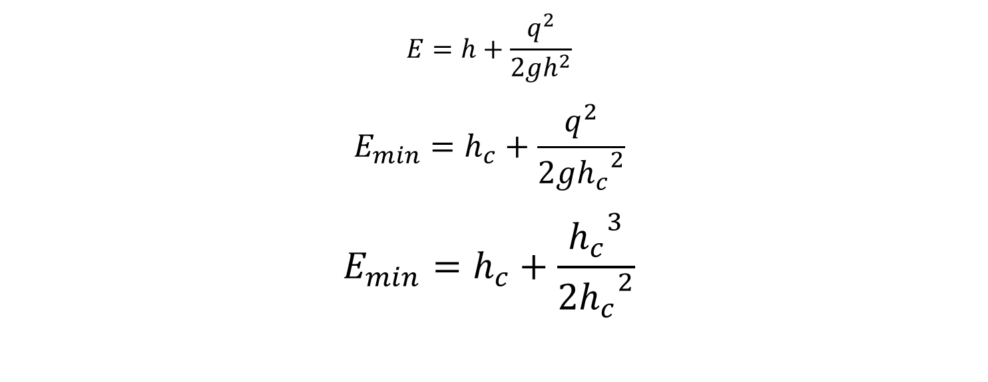
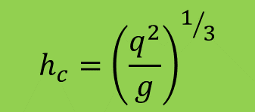
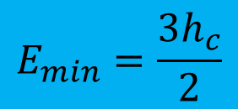
Specific energy in terms of critical depth
$$E=h+\frac{q^{2}}{2gh^{2}}$$
$$E_{min}=h_{c}+\frac{q^{2}}{2g{h_{c}}^{2}}$$
$$E_{min}=h_{c}+\frac{{h_{c}}^{3}}{2{h_{c}}^{2}}$$
$$h_{c}={\left(\frac{q^{2}}{g}\right)}^{1/3}$$
$$E_{min}=\frac{3h_{c}}{2}$$

Slide 12
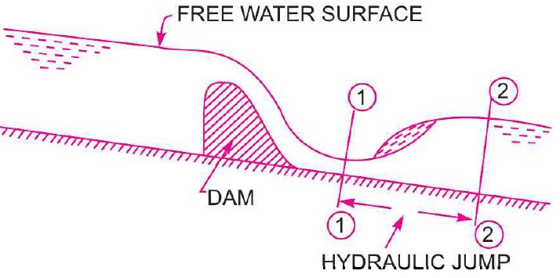
Hydraulic jump
The rise of water level, which takes place due to the transformation of the Unstable Shooting (Super-Critical) Flow to the Stable Streaming (Sub-Critical) Flow.

Slide 13
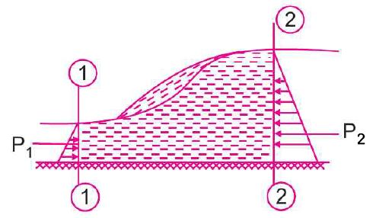
Hydraulic jump – Expression for Depth
In the analysis of hydraulic jumps, the following assumptions are made
The Flow is Uniform and Pressure Distribution is due to Hydrostatic; before and after the Jump.
Losses due to Friction on the surface of the bed of the channel are Small and hence Neglected.
The Slope of the bed of the channel is very Small, so that the Component of the Weight of the fluid in the direction of the flow is Neglected.

Slide 14
Hydraulic jump – Expression for Depth
Forces acting on the Mass of water b/w sections 1 and 2
Pressure Force, p₁
Pressure Force, p₂
Frictional Force - on the floor of the channel

Slide 15


